Slide 1
Test plant energy saving
Raspberry PI Automation
August 2016

Slide 2
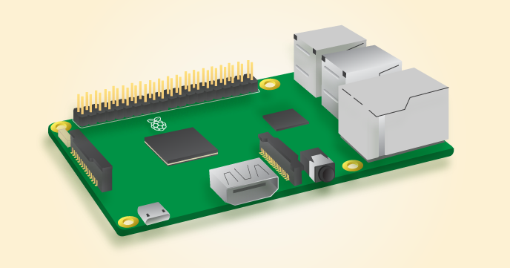
Raspberry PI 3 (RPI) Overview
1.2GHz 64-bit quad-core ARMv8 CPU
802.11n Wireless LAN
Bluetooth 4.1 (BLE)
1GB RAM
4 USB ports
40 GPIO pins (26 usable for IO Control)
Full HDMI port
Ethernet port
Micro SD card slot
Official OS Raspbian based on Debian Jessie linux dstribution

Slide 3
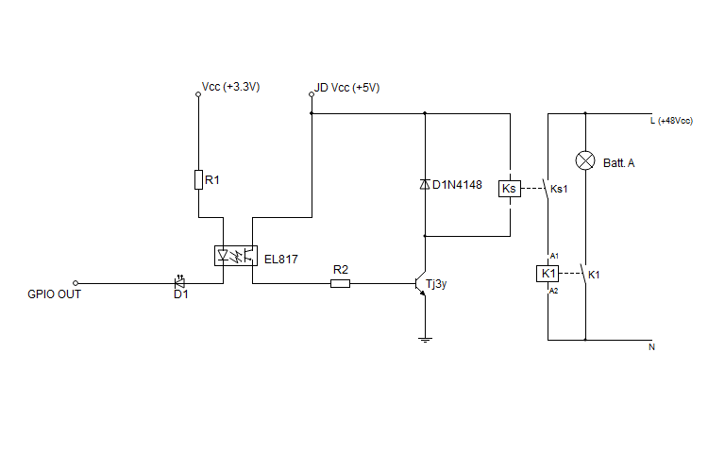
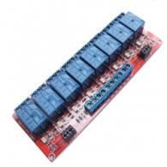
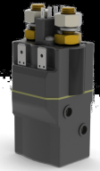
General IO Configuration 1
Not Applicable
Ks: SRD-05VDC-SL-C
Input Voltage: 5V DC
Output Ratings: 10A – 250V AC
K1: Albright SU60 100A DC SPST
Input Voltage: 48V DC
Output Ratings: 100A – 48V DC

Slide 4
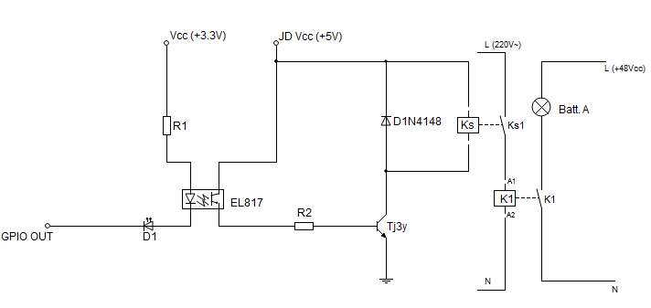
General IO Configuration 2
Not adopted
Ks: SRD-05VDC-SL-C
Input Voltage: 5V DC
Output Ratings: 10A – 250V AC
K1: Albright SW80-81 SPST
Input Voltage: 220AC
Coil power dissipation 8.23W
Output Ratings: 190A – 60V DC

Slide 5
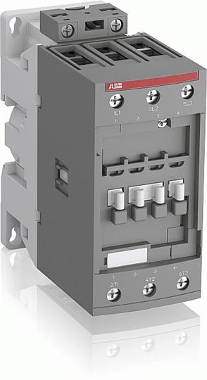
General IO Configuration 3 (implemented)
Ks: SRD-05VDC-SL-C
Input Voltage: 5V DC
Output Ratings: 10A – 250V AC
K1: ABB AF26300013 3PST
Input Voltage: 220AC
Coil power dissipation ?
Output Ratings: 45A – 72V DC
K1: ABB AF52300013 3PST
Input Voltage: 220AC
Coil power dissipation ?
Output Ratings: 100A – 72V DC

Slide 6
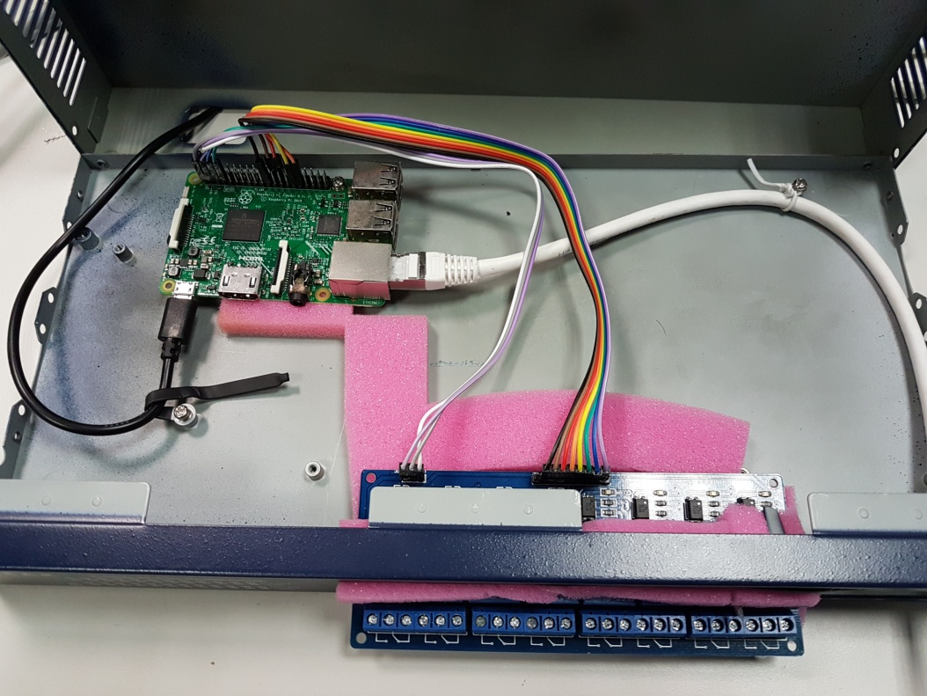
Demo Plant – Raspberry & SRD-05VDC Module case

Slide 7
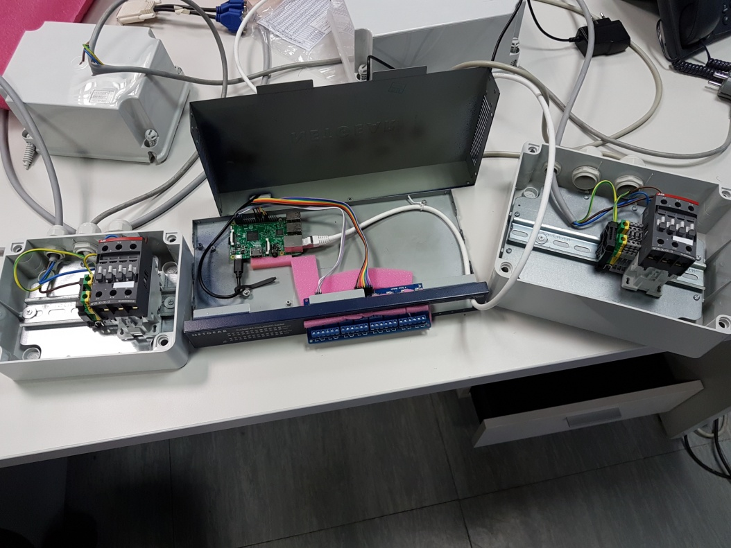
Demo Plant – Raspberry & SRD-05VDC Module case

Slide 8
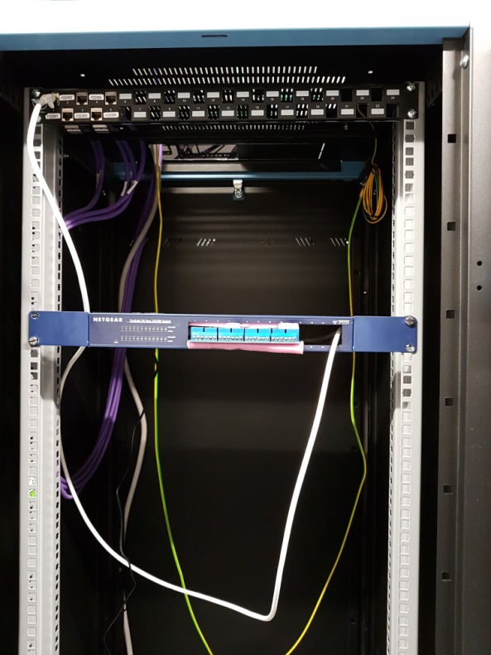
Demo Plant – Installation

Slide 9
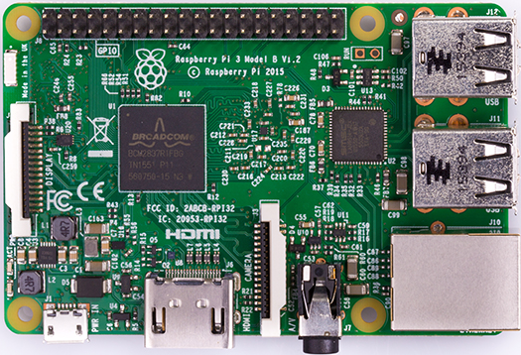
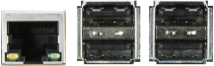
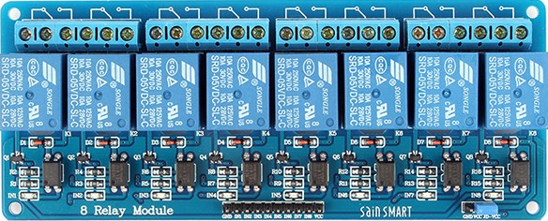
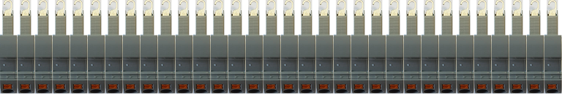
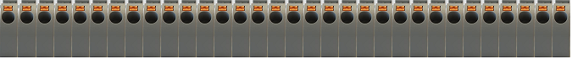
PI Relay Control Chassis layout 1/2
A/V
HDMI
POWER
Rear view
ETH
USB
RPI
Left view
Top view
Relay #2
Relay #1
Terminal blocks (#32)
16 16C ... … 2 2C 1 1C
Front view

Slide 10
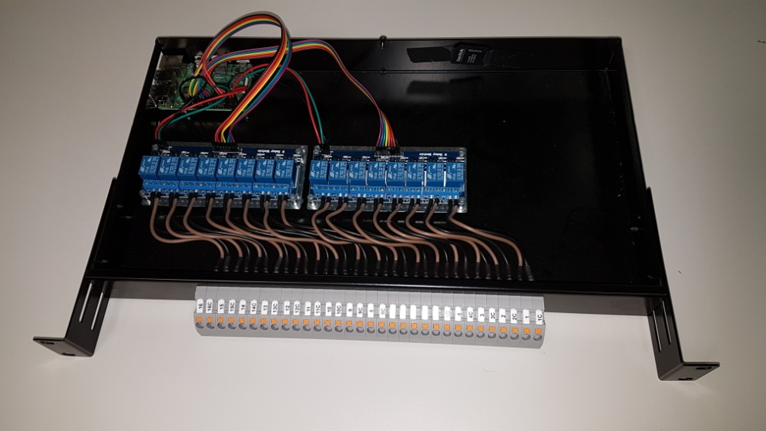
PI Relay Control Chassis layout 2/2
Ks NC status has been adopted
This configuration will produce the following rack behavior:
Racks powered ON in default case
Racks powered ON in case of RPI unpowered (i.e. damage)
Racks powered OFF just after RPI explicit command input

Slide 11
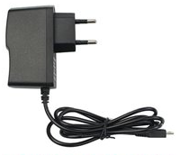
PI Relay Control components 1/3 (RPI v3)
56mm
85mm
RPI v3

Slide 12
PI Relay Control components 2/3 (8 Relay module)
138 mm
50 mm
8 Relay module

Slide 13
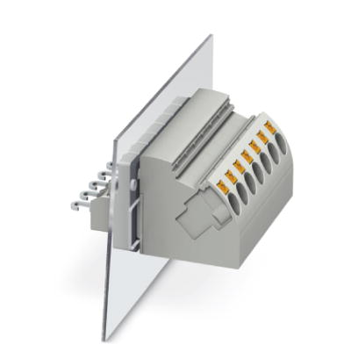
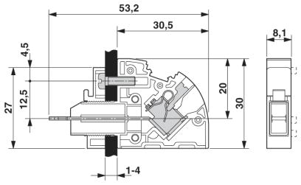
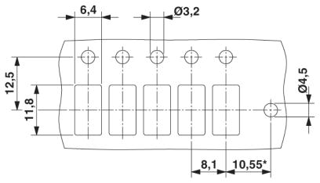
PI Relay Control components 3/3 (Terminal block)
Phoenix PW4-POT-SL
(3059731)

